Slide 1

DATA STRUCTURE WEEK SEVEN
Contact Details:
Email: sobia.iftikhar@nu.edu.pk
GCR:

Slide 2
Efficient/Advance sorting techniques
Shell Sort
Heap sort
Quick Sort
Merge Sort
Radix Sort
Counting Sort

Slide 3
Class One

Slide 4
Merge Sort
An efficient sorting algorithm for large arrays, based on the general principle of “divide and conquer”

Slide 5
Merge Sort
Thus, it gets completed in three steps:
1. Divide: In this step, the array/list divides itself recursively into sub-arrays until the base case is reached.
2. Recursively solve: Here, the sub-arrays are sorted using recursion.
3. Combine: This step makes use of the merge( ) function to combine the sub-arrays into the final sorted array.

Slide 6
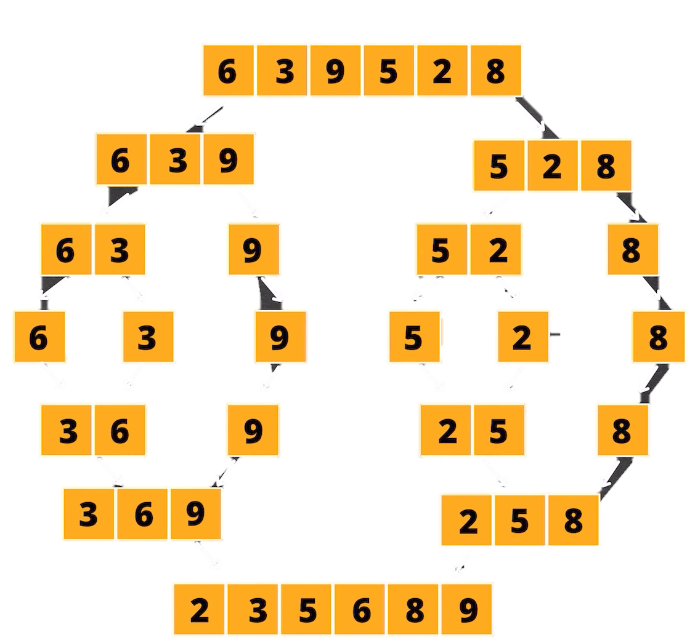
Example Divide & Conquer
6 | 3 | 9 | 5 | 2 | 8
3 | 6 | 9
2 | 5 | 8
Compare 3 and 2 place 2
Compare 5 and 3 place 3
Compare 6 and 5 place 5
Compare 8 and 6 place 6
Compare 9 and 8 place 8
2 | 3 | 5 | 6 | 8 | 9

Slide 7
Dry Run
6 | 3 | 9 | 5 | 2 | 8
MergeSort(arr[], l, r) If l < r
Find the middle point to divide the array into two halves:
middle m = l + (r – l)/2
Call mergeSort for first half:
Call mergeSort(arr, l, m)
Call mergeSort for second half:
Call mergeSort(arr, m + 1, r)
Merge the two halves sorted in steps 2 and 3:
Call merge(arr, l, m, r)
9 | 4 | 7 | 6 | 3 | 1 | 5

Slide 8
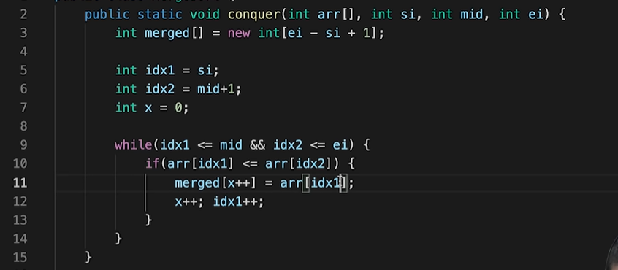
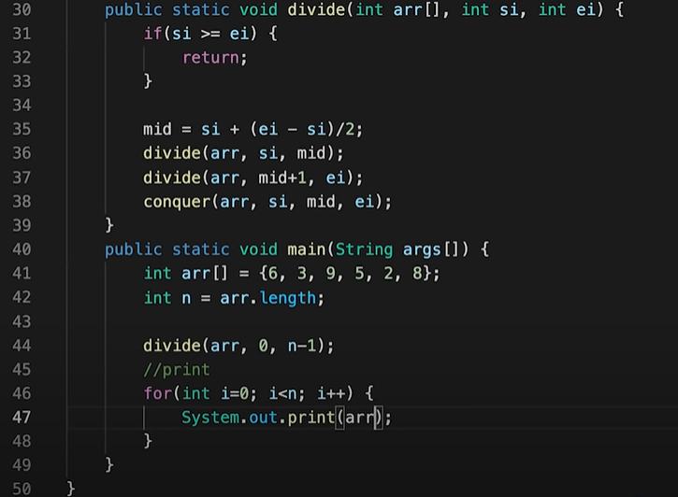
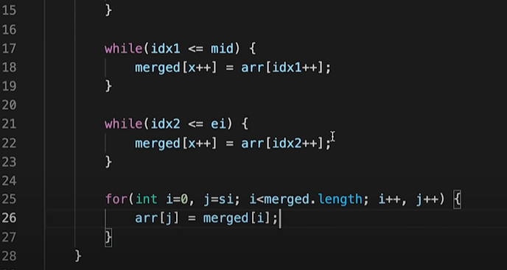
Code Implementation

Slide 9
Time Complexity
Time Complexity sorting n objects, merge sort hs worst-case performance of O(n log n).
Space complexity — if you count stack frames, then it’s O(n)+ O(log n), so asymptotically its O(n)

Slide 10
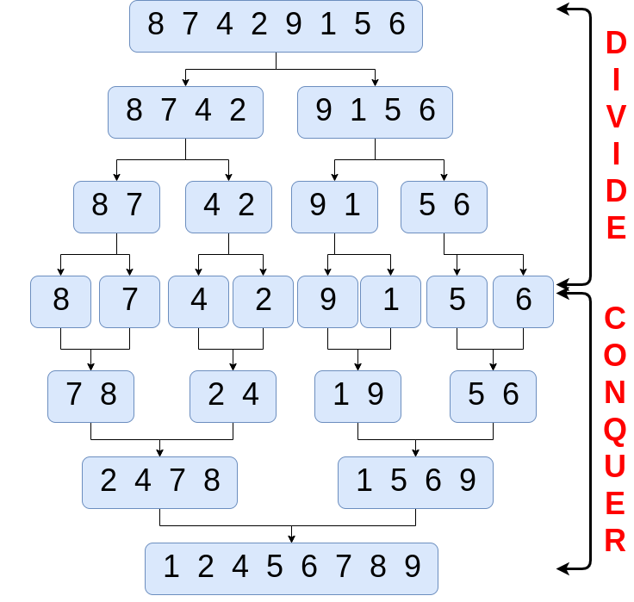
Algorithm
MergeSort(arr[], l, r) If l < r
Find the middle point to divide the array into two halves:
middle m = l + (r – l)/2
Call mergeSort for first half:
Call mergeSort(arr, l, m)
Call mergeSort for second half:
Call mergeSort(arr, m + 1, r)
Merge the two halves sorted in steps 2 and 3:
Call merge(arr, l, m, r)

Slide 11
Quick Sort
Quicksort is a sorting algorithm based on the divide and conquer approach where
An array is divided into subarrays by selecting a pivot element (element selected from the array). While dividing the array, the pivot element should be positioned in such a way that elements less than pivot are kept on the left side and elements greater than pivot are on the right side of the pivot.
Four ways to identify the Pivot:
Take random num from array
Take median
Consider first num of the array
Consider last num of array

Slide 12

Quick Sort consider last element as Pivot
Pivot
Identify the element that is smaller then Pivot point/value, place them on left side and place larger element then Pivot, to the right side.
6|3|5|2
9
Pivot = 8
Smaller then Pivot
larger then Pivot
6|3|5|2
---
6|3|5
Pivot = 2
Smaller then Pivot
larger then Pivot
6|3|5
3
6
Pivot = 5
Smaller then Pivot
larger then Pivot
2 | 3 | 5 | 6 | 8 | 9

Slide 13
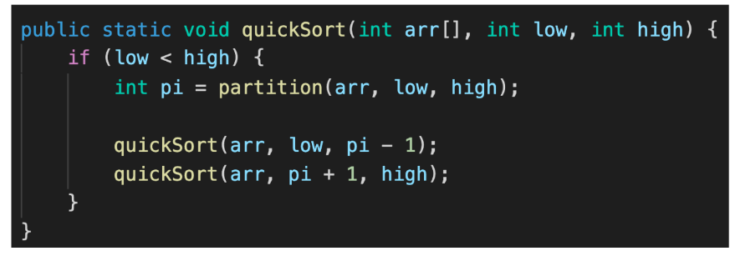
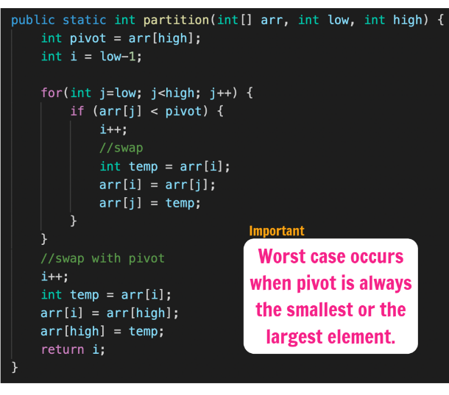
Code
i= -1
Take a element from array compare with Pivot
Parttioned array
6 | 3 | 5 | 2 | 8 | 9
6 | 3 | 5 | 9 | 9 | 9
6 | 3 | 5 | 9 | 9 | 9
I = 1
I = 2
I = 3
I = 4
I = 0
I = 0

Slide 14
Radix Sort
0 | 1 | 2 | 3 | 4 | 5 | 6 | 7 | 8 | 9
.
432 | 008 | 530 | 090 | 088 | 231 | 011 | 045 | 677 | 199
530 | 090 | 231 | 011 | 432 | 045 | 677 | 008 | 088 | 199
pass-1
pass-2
0 | 1 | 2 | 3 | 4 | 5 | 6 | 7 | 8 | 9
1 | 1 | 0 | 3 | 1 | 0 | 0 | 1 | 1 | 2
0 | 1 | 2 | 3 | 4 | 5 | 6 | 7 | 8 | 9
2 | 2 | 1 | 0 | 0 | 1 | 0 | 1 | 2 | 1
0 | 1 | 2 | 3 | 4 | 5 | 6 | 7 | 8 | 9
2 | 4 | 5 | 5 | 5 | 6 | 6 | 7 | 9 | 10
0 | 1 | 2 | 3 | 4 | 5 | 6 | 7 | 8 | 9
1 | 2 | 2 | 5 | 6 | 6 | 6 | 7 | 8 | 10
0 | 1 | 2 | 3 | 4 | 5 | 6 | 7 | 8 | 9
0 | 1 | 2 | 3 | 4 | 5 | 6 | 7 | 8 | 9
530 | 090 | 231 | 011 | 432 | 045 | 677 | 008 | 088 | 199
008 | 011 | 530 | 231 | 432 | 045 | 677 | 088 | 090 | 199
RadixSort(a, n){
int max = GetMax(a, n);
for(pos = 1; max/pos >0 pos*10){ countSort(a, n, pos);}}
countsort(a, n, pos){
int count[10] = {0};
for(i = 0; i<n; i++)
count[ a[i]/pos] % 10 ]++;
for(i= 0; i<10; i++)
count[i] = count[i] +count[i-1];
for(i = n-1; i>0; i - -)
b[ - - count[ (a[i]/pos) % 10]] = a[i];
for(i=0; i<n; i++)
a[i] = b[i];
}
008 | 011 | 530 | 231 | 432 | 045 | 677 | 088 | 090 | 199
pass-3
0 | 1 | 2 | 3 | 4 | 5 | 6 | 7 | 8 | 9
5 | 1 | 1 | 0 | 1 | 1 | 1 | 0 | 0 | 0
0 | 1 | 2 | 3 | 4 | 5 | 6 | 7 | 8 | 9
5 | 6 | 7 | 7 | 8 | 9 | 10 | 10 | 10 | 10
0 | 1 | 2 | 3 | 4 | 5 | 6 | 7 | 8 | 9
008 | 011 | 045 | 088 | 090 | 199 | 231 | 432 | 530 | 677

Slide 15
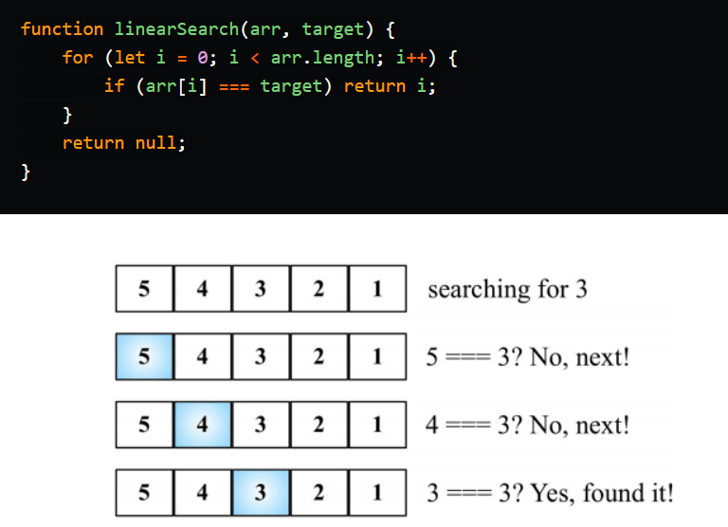
Linear Search
Linear Searching:
Linear search is used to search a key element from multiple elements.
Algorithm:
Step 1: Traverse the array
Step 2: Match the key element with array element
Step 3: If key element is found, return the index position of the array element
Step 4: If key element is not found, return.

Slide 16
Binary Search
A simple Binary Search Algorithm is as follows:
1. Calculate the mid element of the collection.
2. Compare the key items with the mid element.
3. If key = middle element, then we return the mid index position for the key found.
4. Else If key > mid element, then the key lies in the right half of the collection. Thus repeat
steps 1 to 3 on the lower (right) half of the collection.
5. Else key < mid element, then the key is in the upper half of the collection. Hence you
need to repeat the binary search in the upper half.

Slide 17
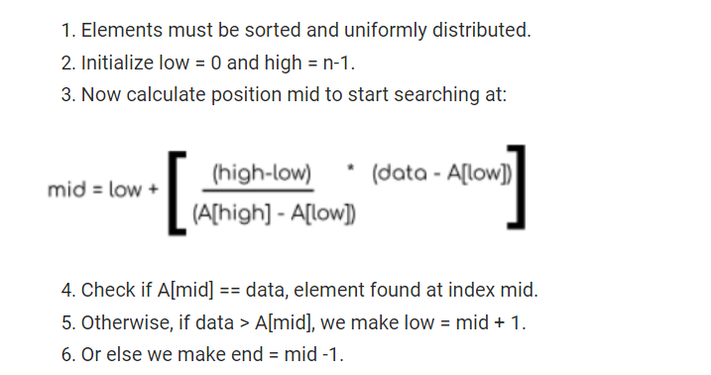
Interpolation Search

